Slide 2
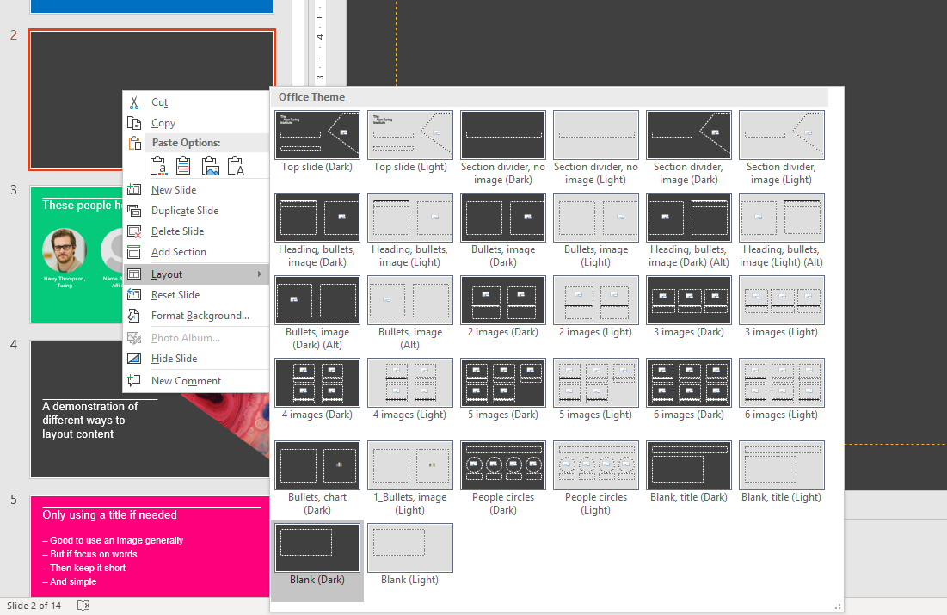
Right click
Layout
Choose a layout
Dark or light backgrounds

Slide 4
Copyright-free images can be found at https://unsplash.com/

Slide 5
Heading | Heading
Text | Text

